Slide 1
Intergalactic Bookstore (WIP)
Level 4/5 Group 14
Alex Polley
Ryan Manthorp
Thomas McLaren
Daniel Pokladek

Slide 2
Summary
Emotions:
Vellichor
Monachopsis
Play as a boostore keeper organising bookshelfs, bookstore contains priceless and dangerous books. Bookstore turns out to be in space

Slide 3
Gameplay
Daniel, Tom

Slide 4
Emotions
Tom

Slide 5
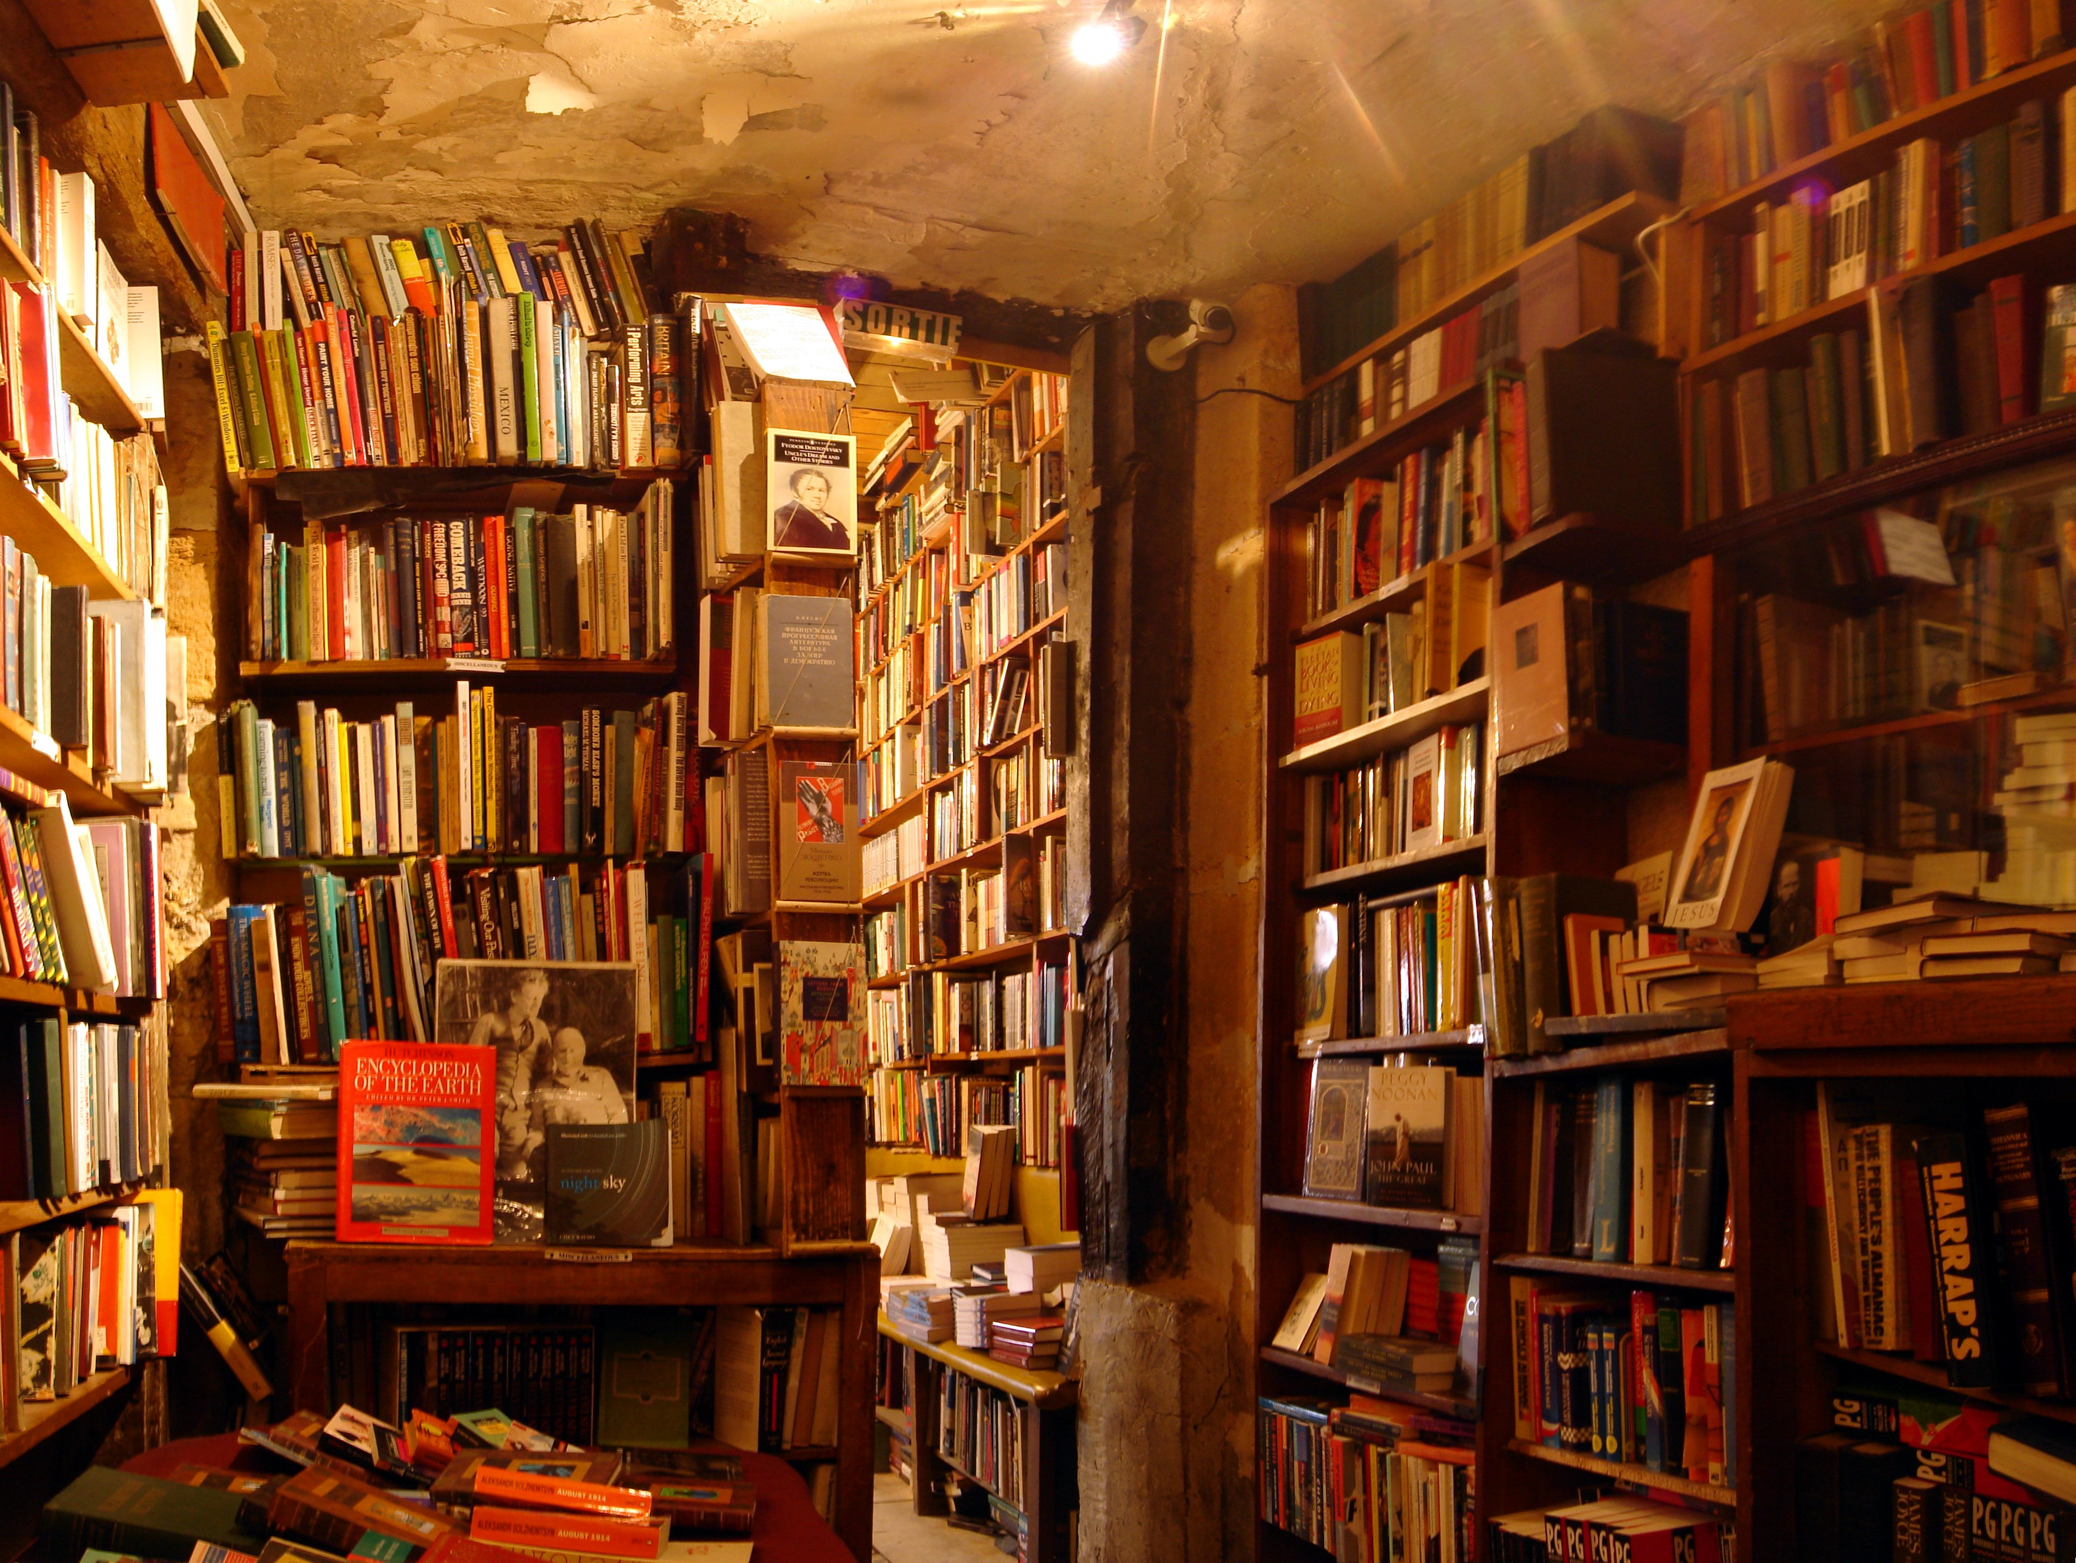
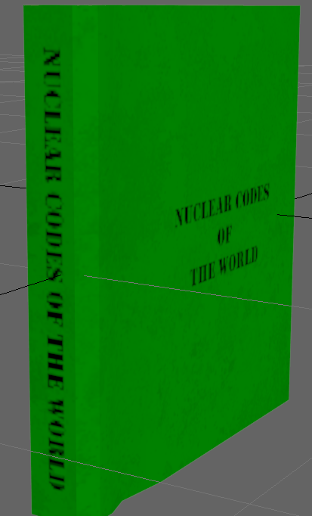
Design/ art choices
All books have grime and dirt on them to give them a old and vintage look
Rooms are dimly lit with warm lighting to make the player feel as if they are in a old bookstore

Slide 6
Changes made
Ryan

Slide 7
Management
Emails sent
Alex- 3
Ryan- 1
Tom- 4
Daniel- 2
Hours logged

Slide 8
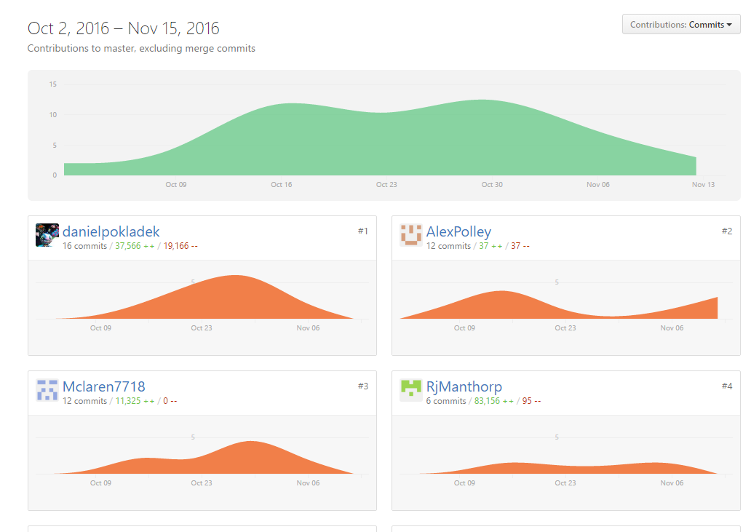
Weekly commits

